Slide 1

MOVIE TICKET BOOKING
Welcome to Our Presentation

Slide 2

NBKR Institute Of Science and Technology
Guided By:
Presented by:
Sivanraj Samy
K.Rajesh
M.Rajesh
L.Sreenadh reddy
K.Vijay reddy

Slide 3
ABSTRACT
This project is aimed to provide the customers facility to book tickets for cinema halls online, through which they can book tickets anytime, anywhere.
Movie ticket booking system is basically made for providing the customer an anytime and anywhere service for booking the seat in the cinema hall and to gather information about the movie online. The user can easily be able to know about the movies released and then make the choice.

Slide 4
Problem Statement
Manual ticket booking is time-consuming and inefficient
Long queues and chances of human error
Need for a fast, user-friendly, and automated solution
Secure transactions

Slide 5
Challenges
Handling real-time seat availability
Payment gateway integration
Ensuring responsive UI for all devices

Slide 6
Future Scope
Integration with food ordering at theater
Mobile app version
AI-based movie recommendations

Slide 7
SOURCE CODE
https://www.onlinegdb.com/XmYVVQb4th

Slide 8
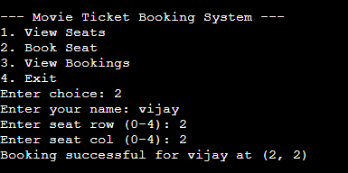
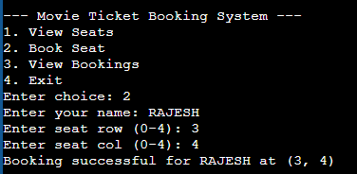
SAMPLE
OUTPUT

Slide 9
CONCLUSION
The Movie Ticket Booking System simplifies the traditional ticket purchasing process by offering a seamless and efficient online platform. It provides a user-friendly interface, real-time seat availability, and secure booking, significantly enhancing the movie-watching experience. This system not only benefits customers but also helps theaters manage operations more effectively

Slide 10
Thank YOU

